Slide 1




Nostr Wallet Connect
A protocol for seamless apps <-> wallet communication
Chiang Mai Bitdevs 03, 2024
Roland Bewick

Slide 2
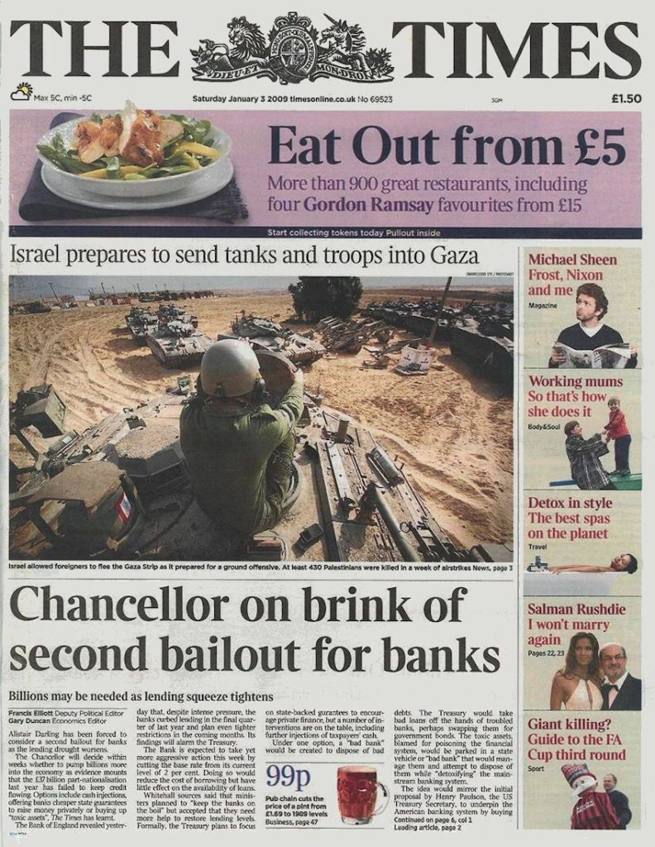

Slide 3

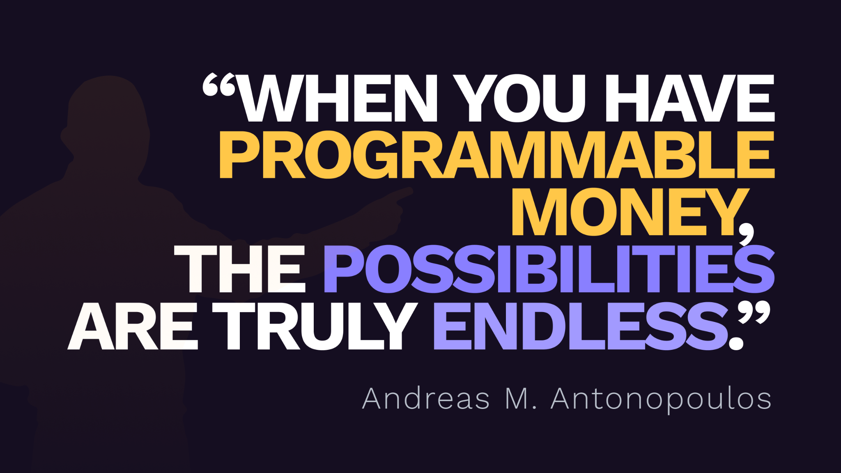

Slide 5
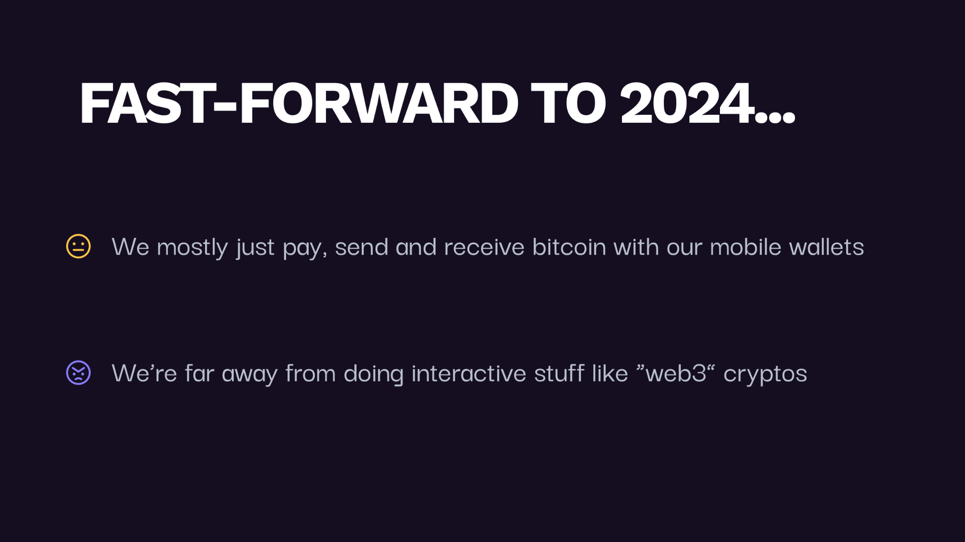

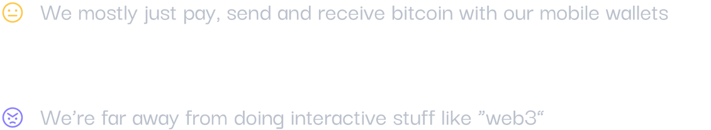

Bitcoin Apps And Bitcoin Wallets

Slide 6


Most bitcoin apps work like closed systems
User
Apps
Create Account
Create Identity
Create Wallet
Same again
X different accounts
X different identities
X different wallets
and again
and again
…

Slide 7
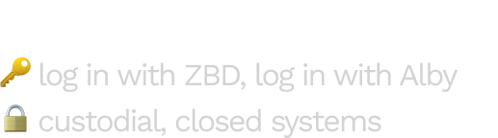

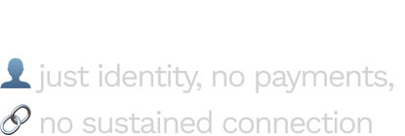
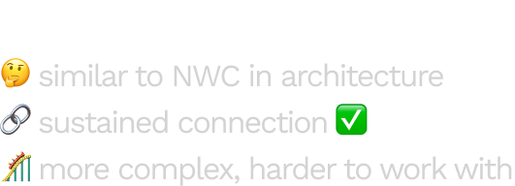
Notes:
LNC:
More focused on deep LND integration
Incompatible & no adoption from other lightning implementations
Does not work for custodial wallets
Supports only 1 connection at a time
Requires copying seed phrase

Slide 8
…need an open communication protocol between apps and wallets….

Slide 9
The future of Wallets and Apps is …
Wallets
Apps
… integrated: One wallet is connected to several apps
… interoperable: One app is powered by several wallets
a Multiverse of Wallets and Apps

Slide 10
























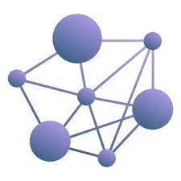
NWC
Nostr Wallet Connect: The protocol connecting Wallets and Apps
Wallets
Apps

Slide 11

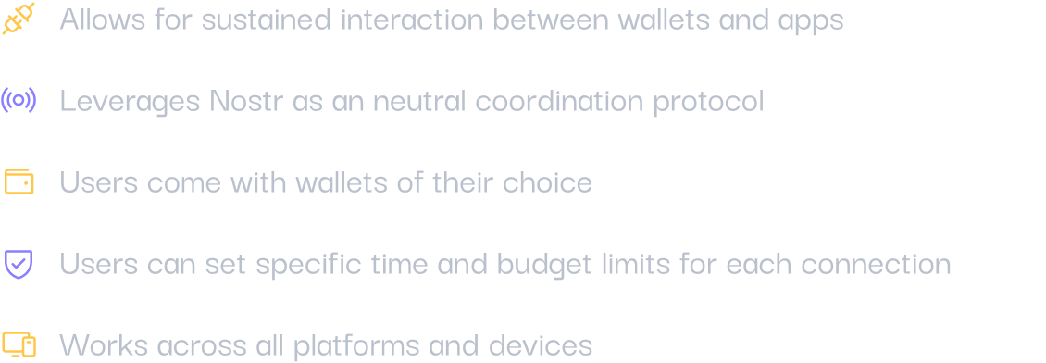

Slide 12
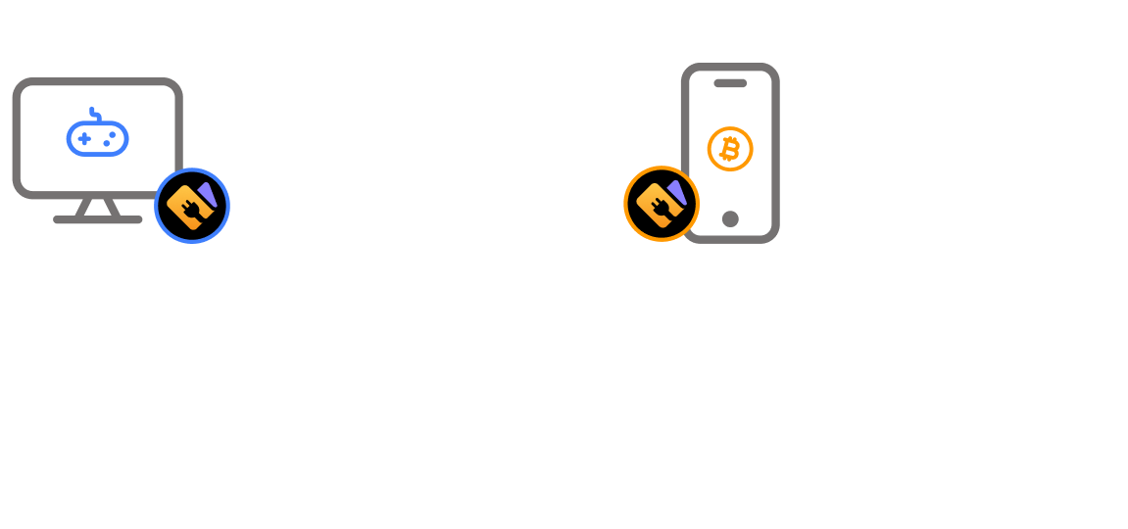

Slide 13
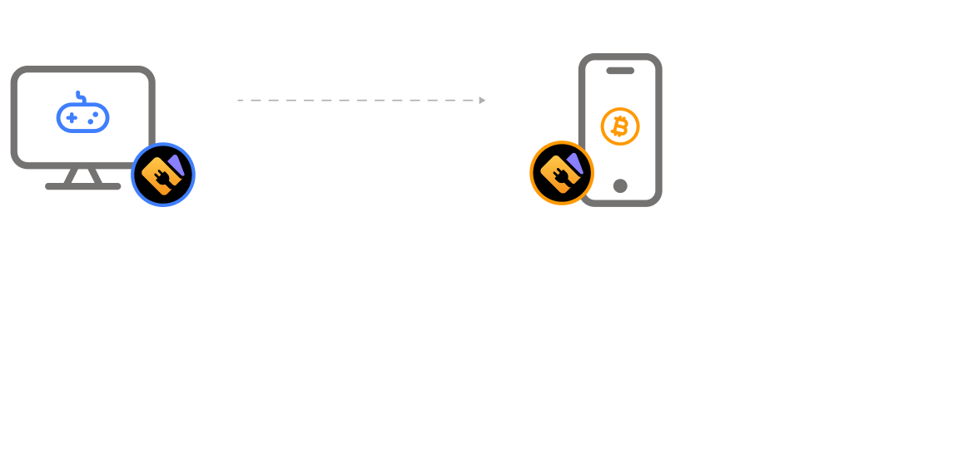

Slide 14
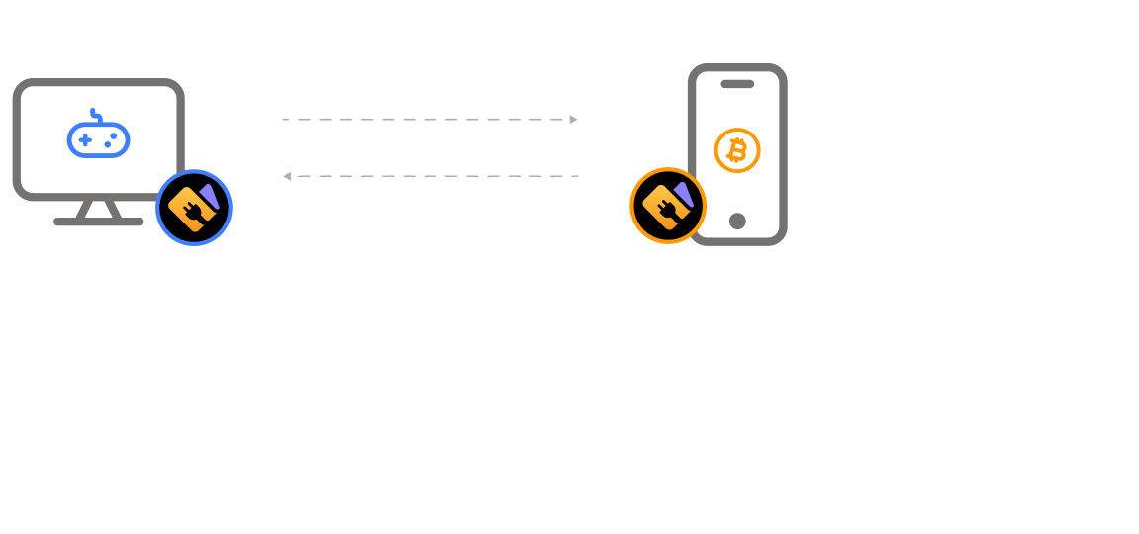

Slide 15
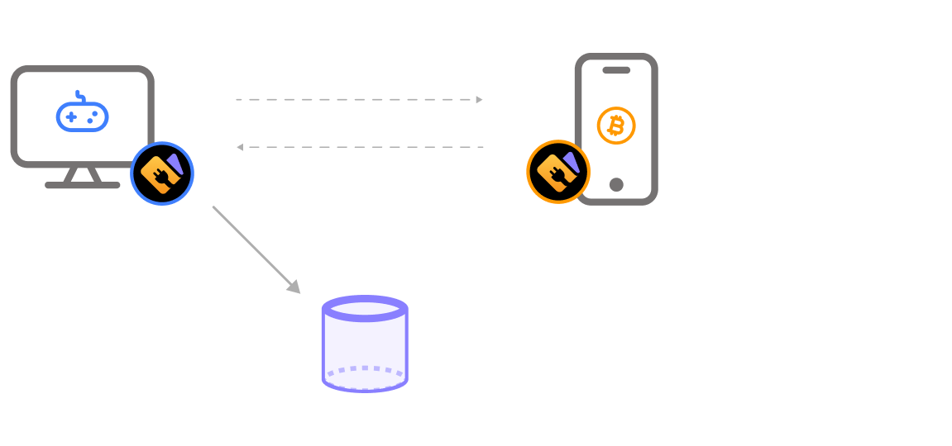

Slide 16
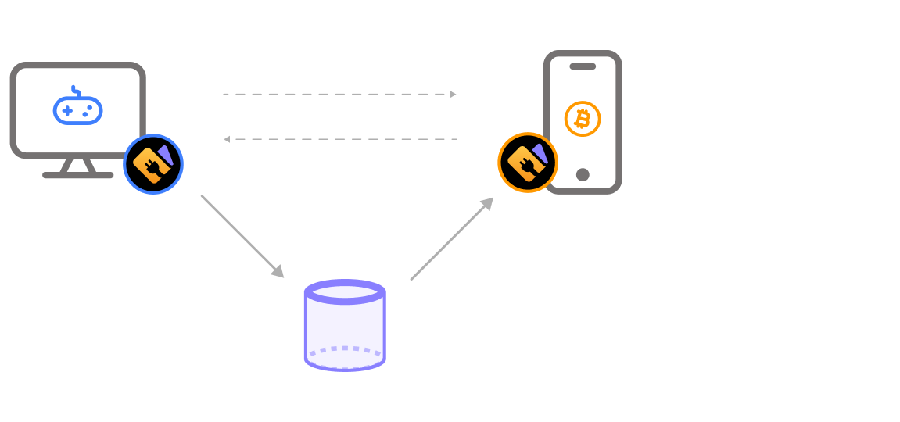

Slide 17
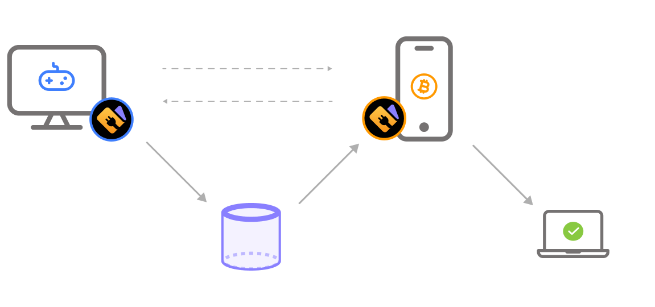

Slide 18


Slide 19
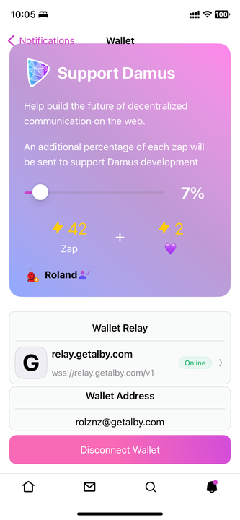
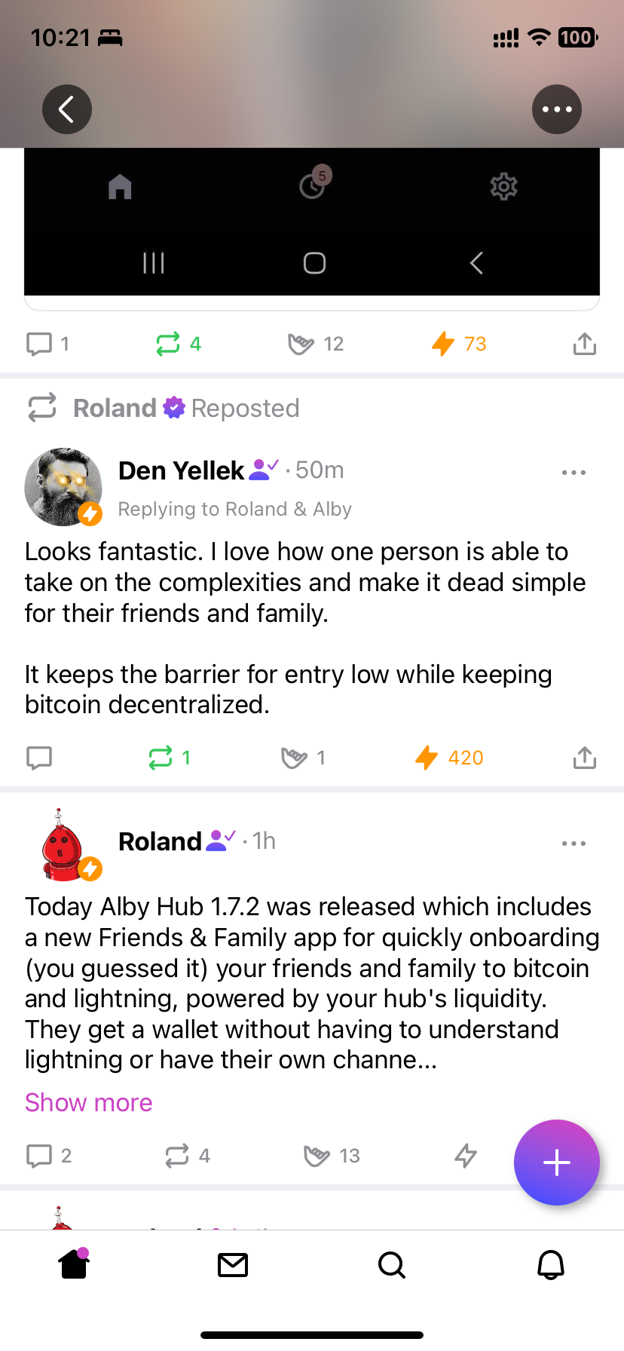
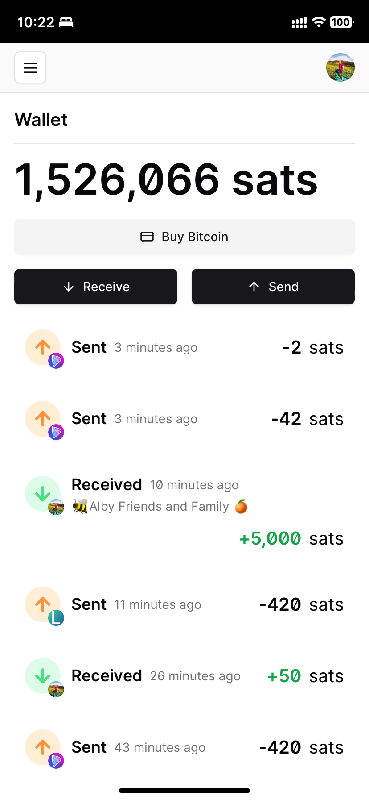

Slide 20


Slide 21
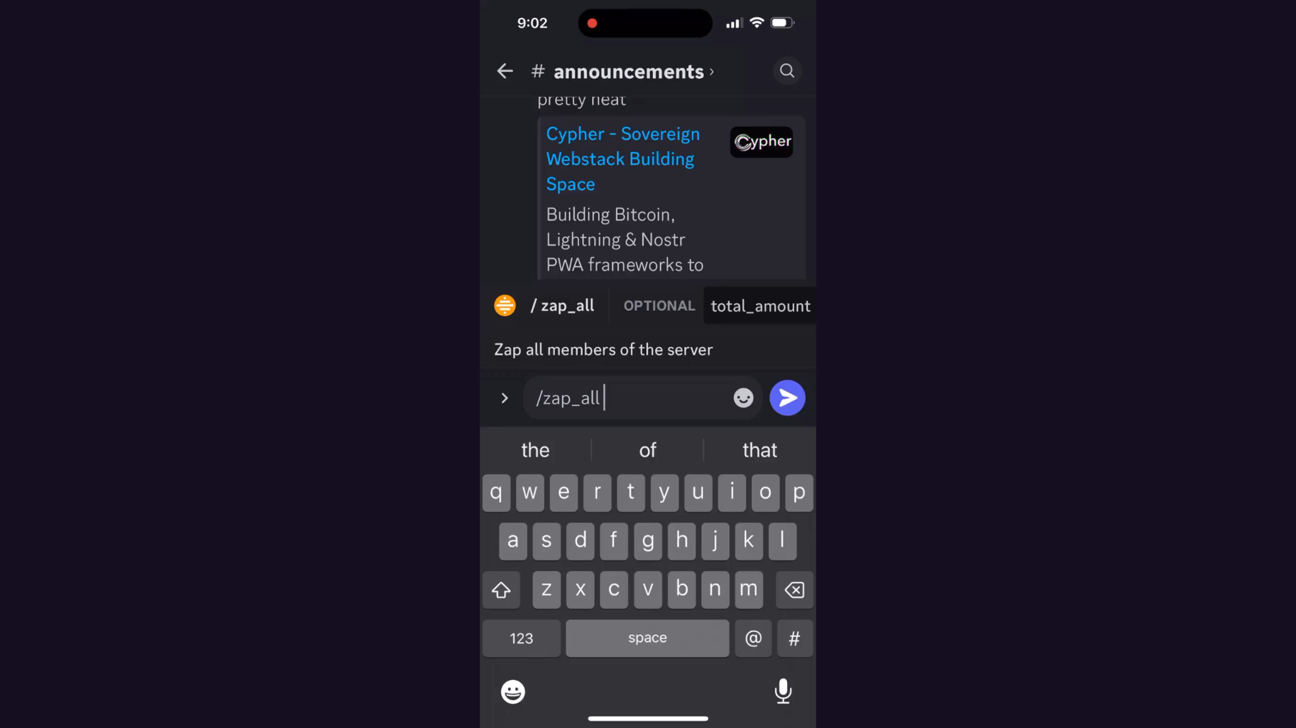

Slide 22
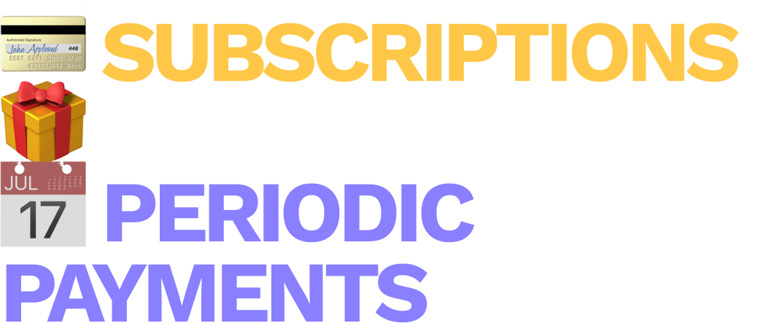

Slide 23
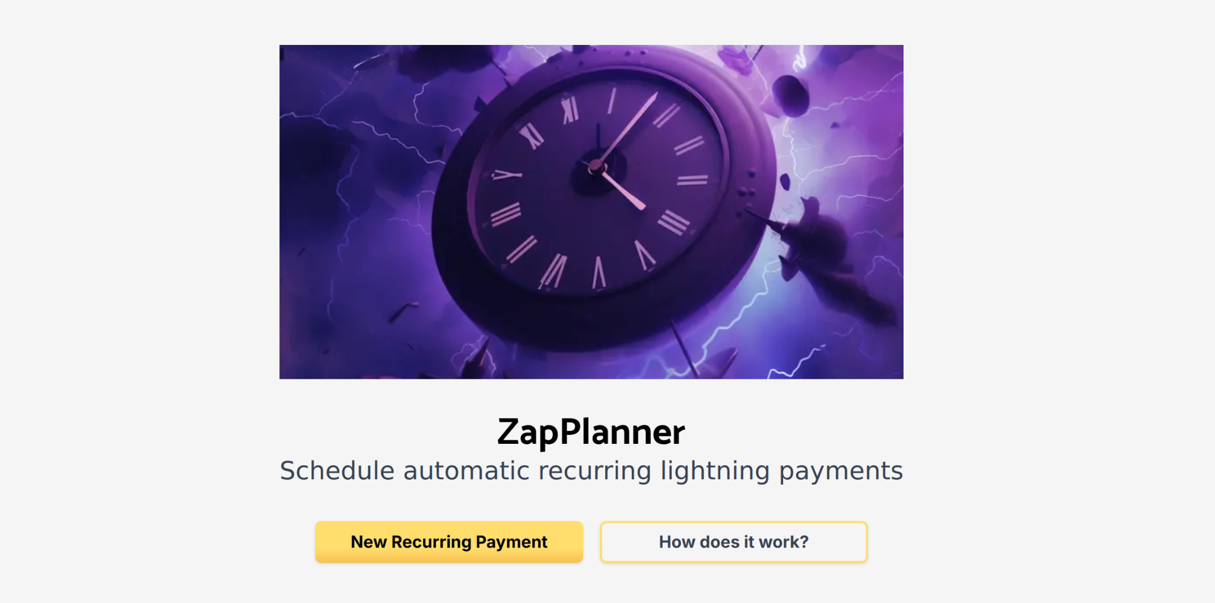

Slide 24


Slide 25


Slide 26


Slide 27
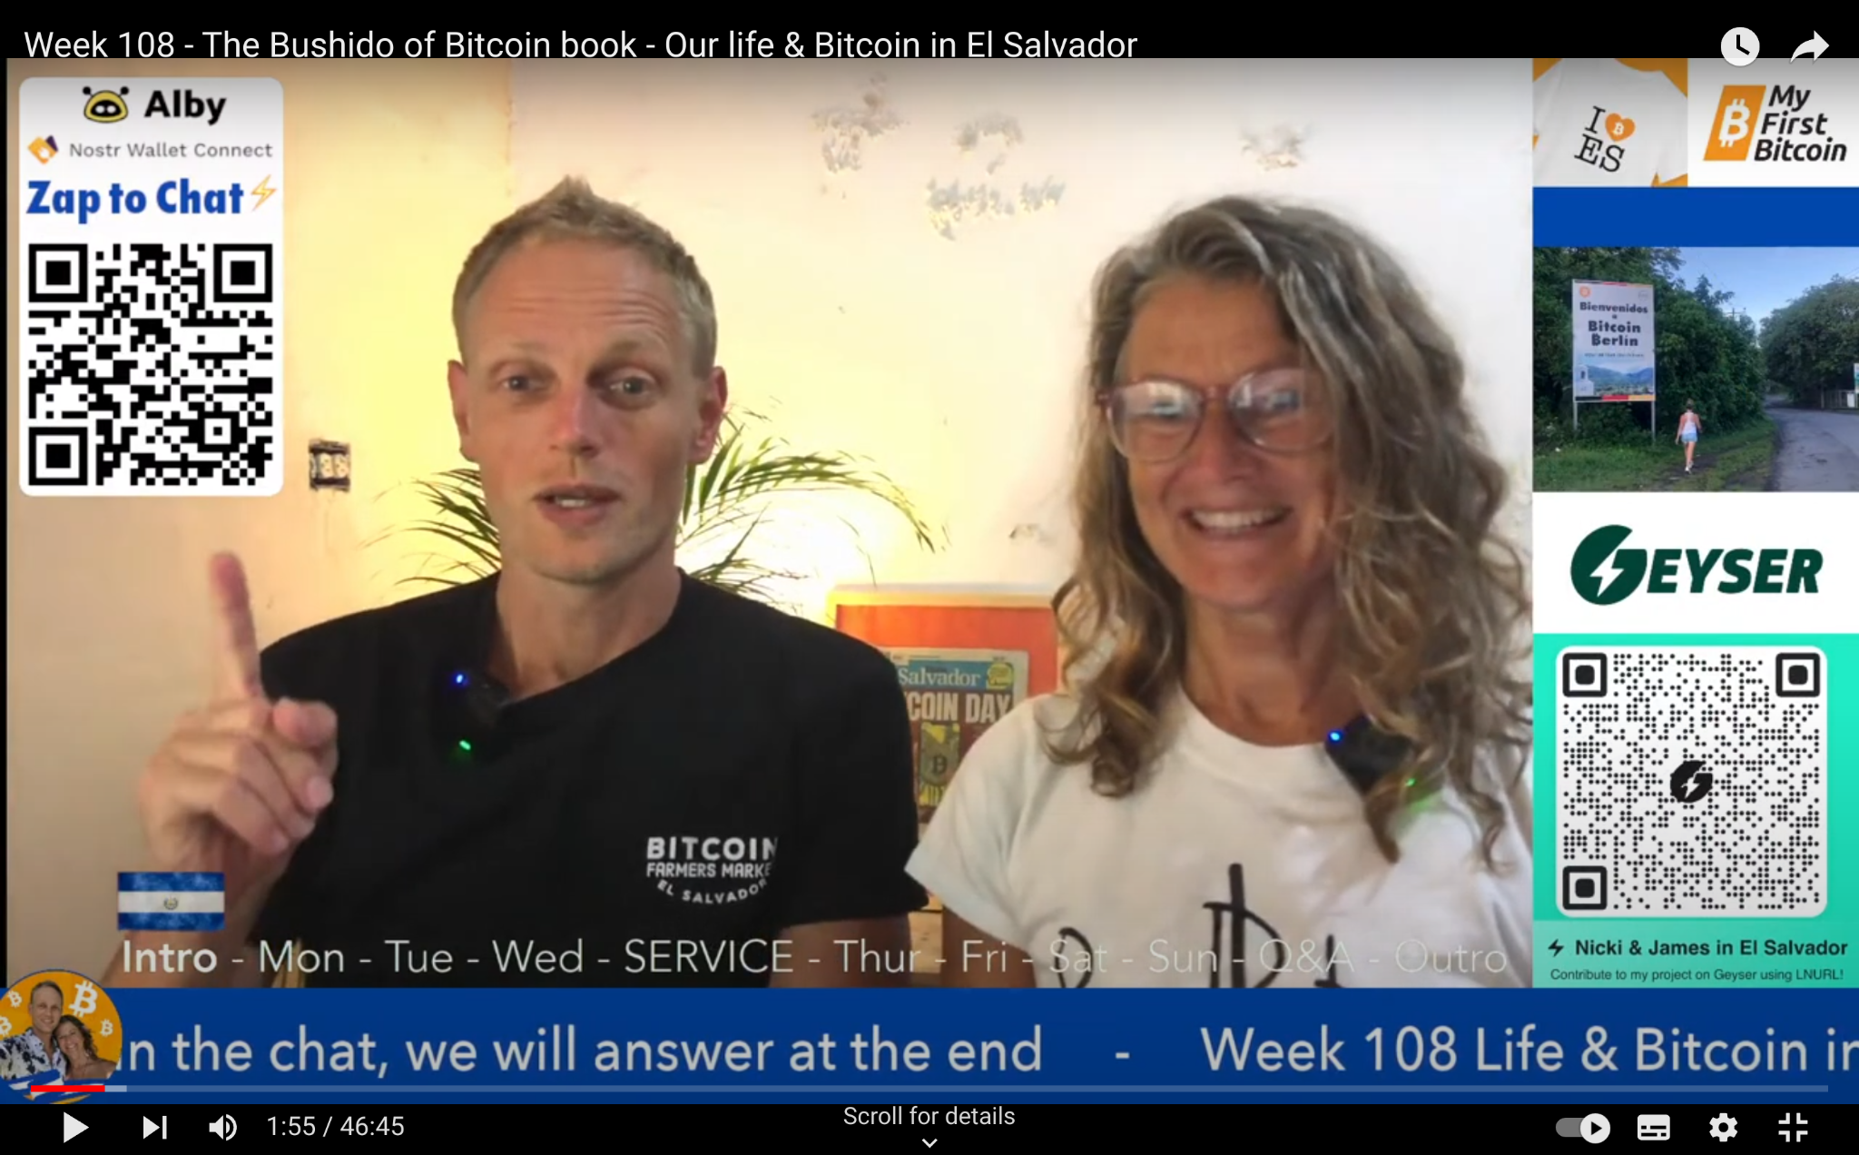

Slide 28


Slide 29
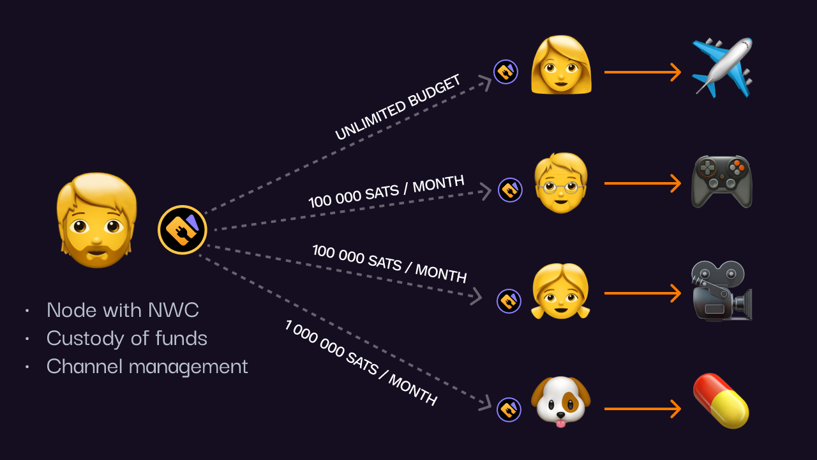

Slide 30
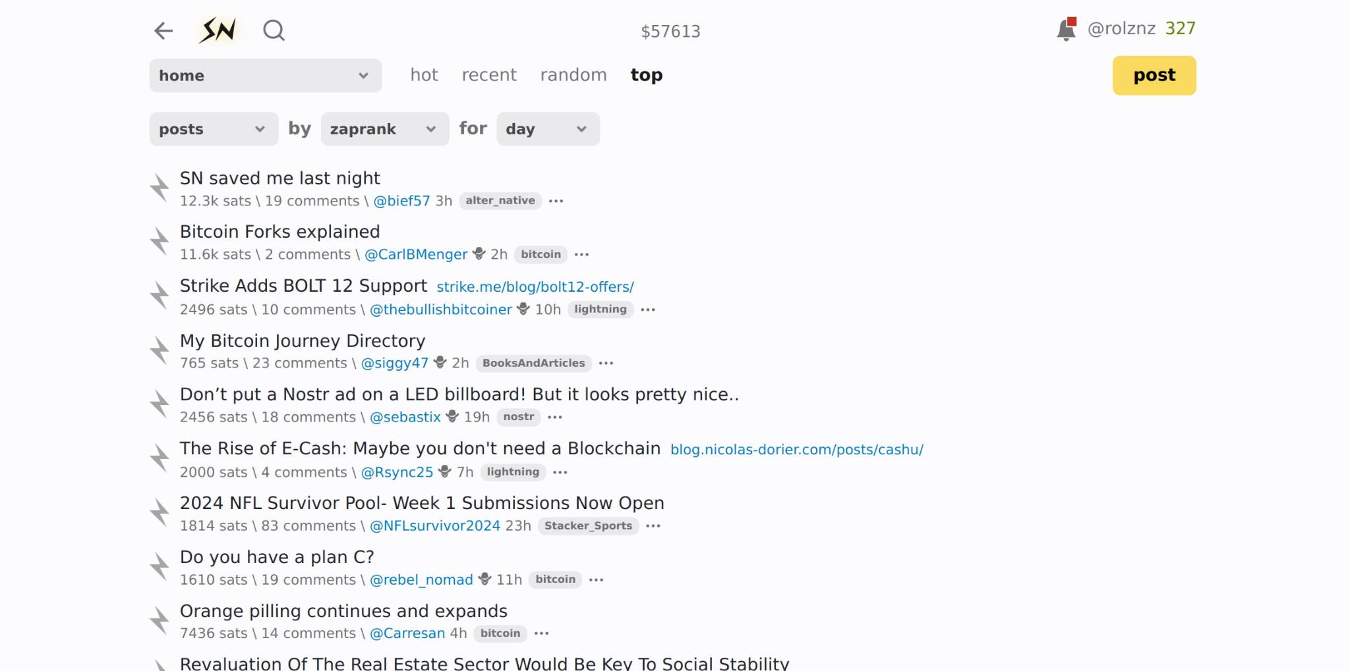

Slide 31
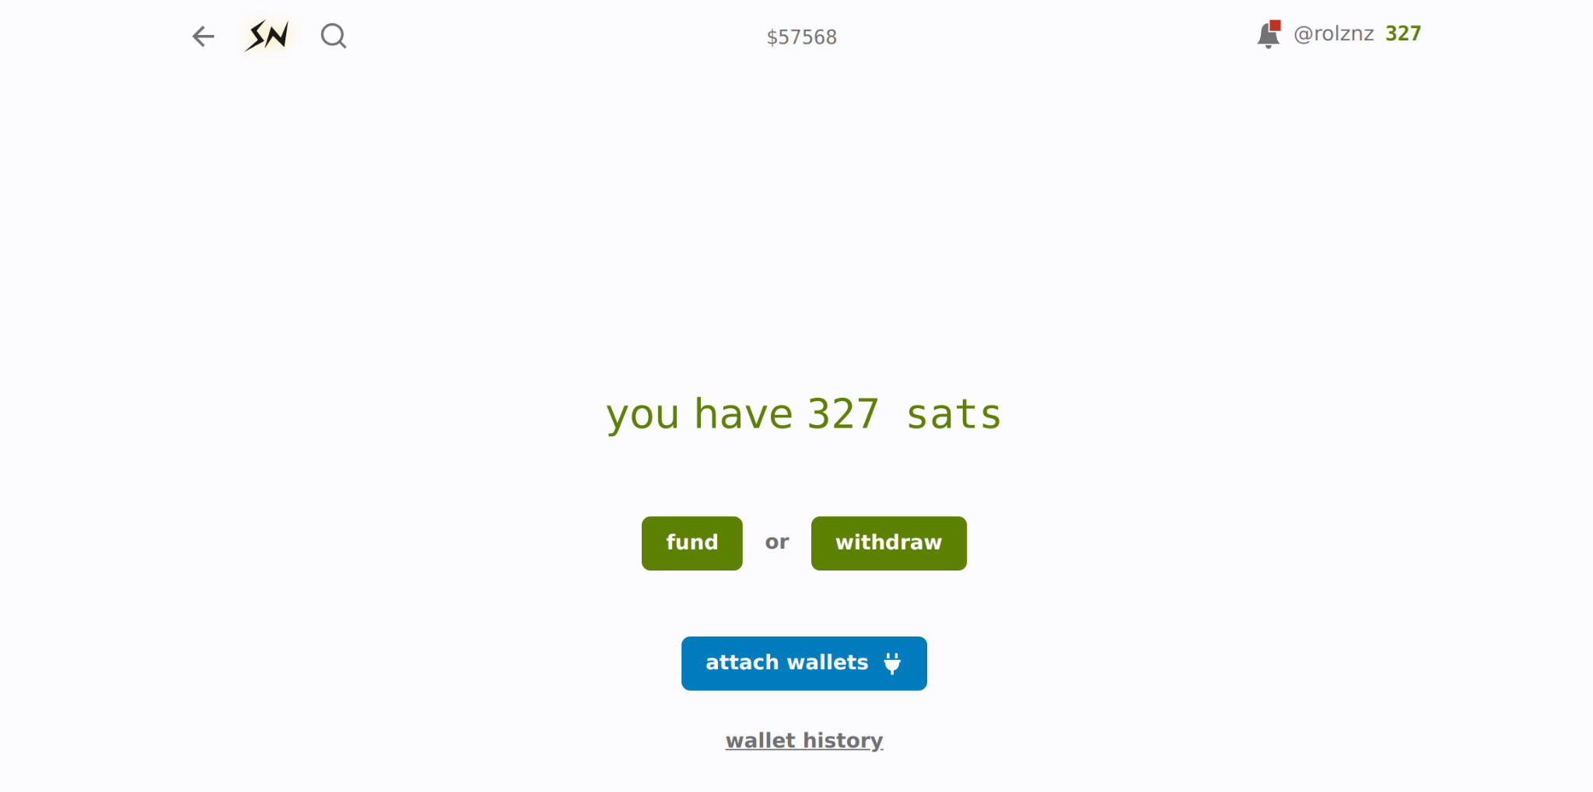

Slide 32
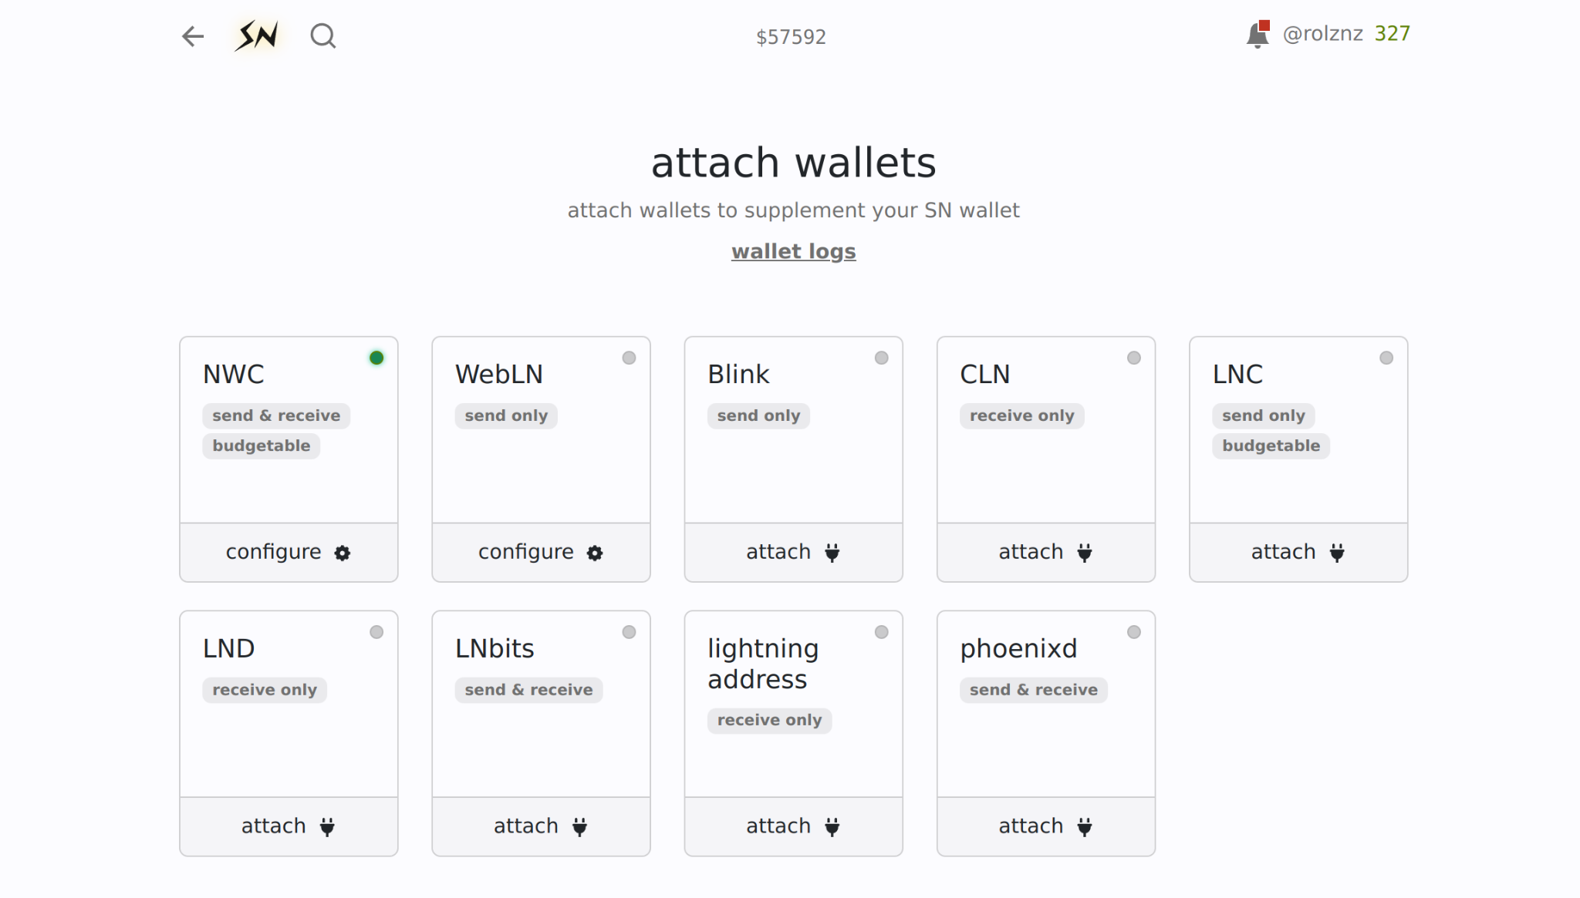

Slide 33
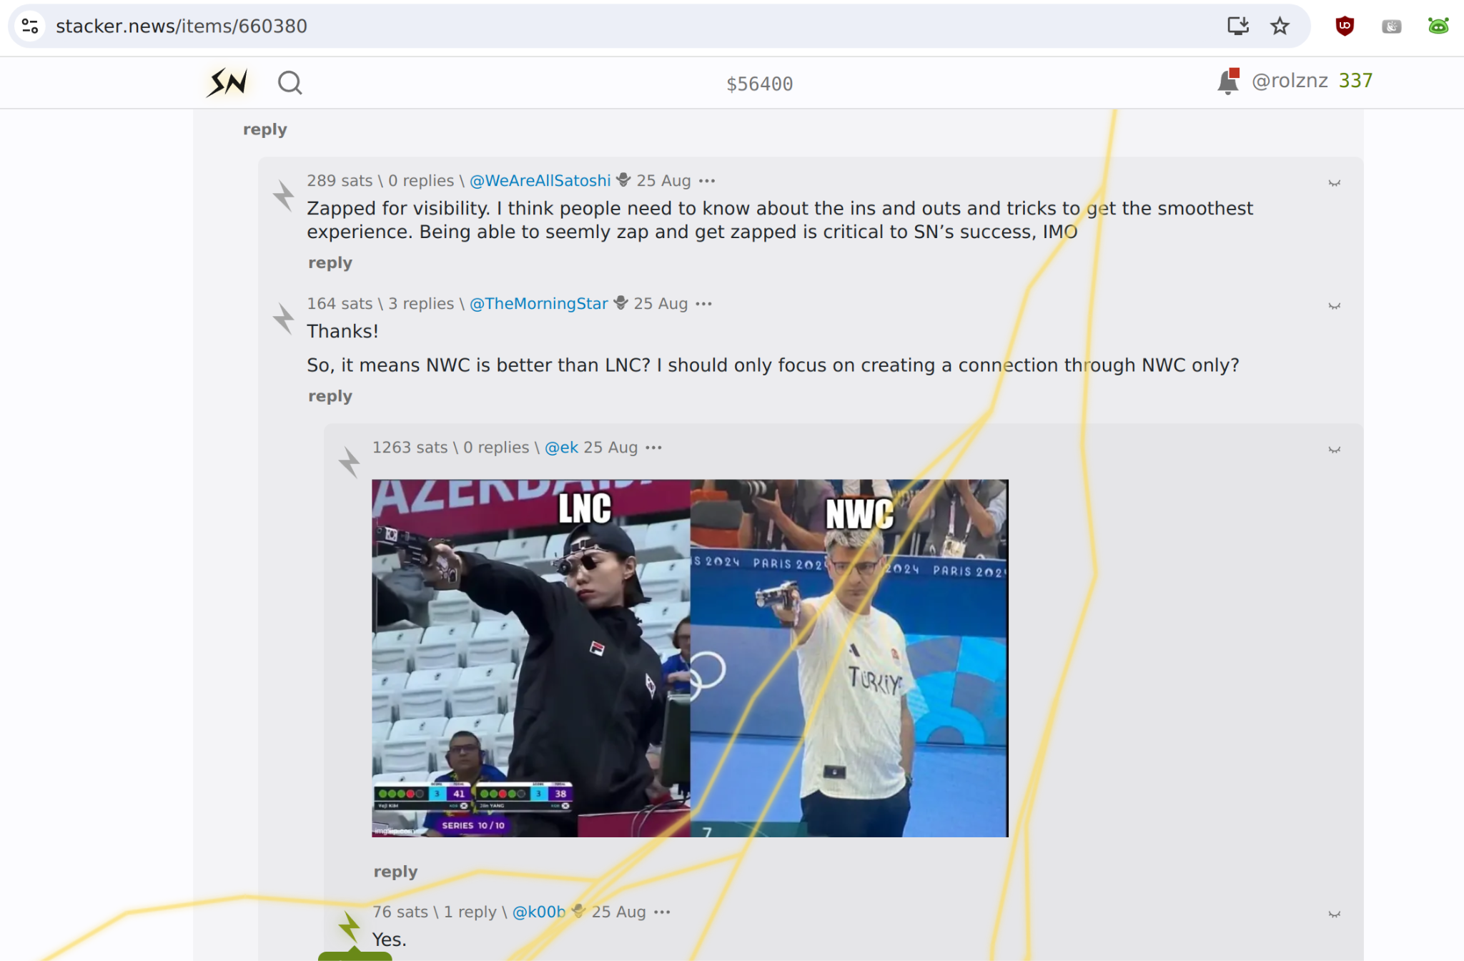

Slide 34
Adoption 📈
Wallet Services Alby Hub
LNbits Lifpay Minibits Cashu.me Lnfi Bankify …
Wallet Backends LND
LDK
Phoenixd
Greenlight
Breez
Cashu
Apps Damus
Amethyst
Nostrudel
Stacker News
Wavlake LBE Alby Go
20+ more…
Development Kits Alby JS SDK
Bitcoin Connect
rust-nostr
NDK
http-nostr
$prism nwc dart
nwc flutter
nwc-ts
Awesome NWC - Interoperability Tracker - nwc.dev

Slide 35
NIP-47 Protocol Development
Basic Wallet functionality ✅
Notifications ✅
1-Click secure App Connection Flow
BOLT-12
HODL payments
Create app connections via NWC
Migration from NIP-04

